Slide 1

Customer Support Ticket Classification Model
Machine Learning Approach
Automating e-commerce ticket categorization to improve efficiency and customer satisfaction.

Slide 2

Problem Statement
E-commerce platforms like Flipkart handle thousands of daily tickets on billing, tracking, and technical issues. Manual classification is time-consuming, inconsistent, and error-prone, leading to slower resolutions and reduced satisfaction.
This project focuses on applying classification techniques to real-world customer service data.

Slide 3

Objectives and Categories
01
Develop Automated Model
Classify tickets into: Billing Issue, Technical Problem, Order Status, General Query.
02
Handle Invalid Inputs
Return "Provide Valid Description" for empty or meaningless text.

Slide 4

Business Motivation
Reduce Manual Effort
Ensure Consistency
Enhance Experience
Automate sorting to save time for support teams.
Improve accuracy and reduce human error in classification.
Prioritize and route tickets faster for quicker resolutions.

Slide 5

Dataset Overview
1750
3
442
Total Records
Columns
Technical Problem
Balanced across four categories plus invalid cases.
TicketID, Description, Category.
Largest category with 442 samples.

Slide 6
Implementation Steps
Load Dataset
Data Preprocessing
TF-IDF Vectorization
Model Training
Hyperparameter Tuning
Cross-Validation
Model Selection
Evaluation on Test Data
Model Saving
Deployment (Flask App)

Slide 7
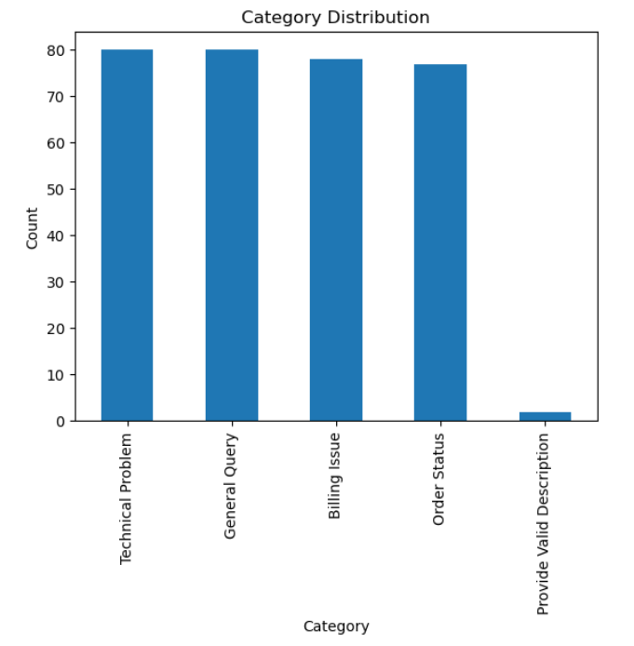



Preprocessing Pipeline
Handle Missing & Duplicates
Remove rows with missing Description/Category; drop duplicates; reset indices for unique TicketIDs.
Text Cleaning
Lowercase text; remove numbers, punctuation via regex; tokenize; remove stopwords; lemmatize using WordNet.
Save Cleaned Data
Output to flipkart_ticket_dataset_cleaned.csv; verify balance: ~430-440 per category. Generate bar chart for distribution.

Slide 8
Feature Engineering with TF-IDF
Transform raw text into numerical vectors for ML models. TF-IDF captures key terms like “refund” over common words like "order“.
Vectorizer Settings
ngram_range=(1,2) for unigrams and bigrams (e.g., "reset password"); max_features=5000 to limit vocabulary; stop_words='english'; use_idf=True for weighting.
Output
Sparse vectors of size 5000 per ticket. Matrix: rows = ticket count, columns = features. Enables models to distinguish categories effectively.
High-dimensional features suit sparse text data.

Slide 9
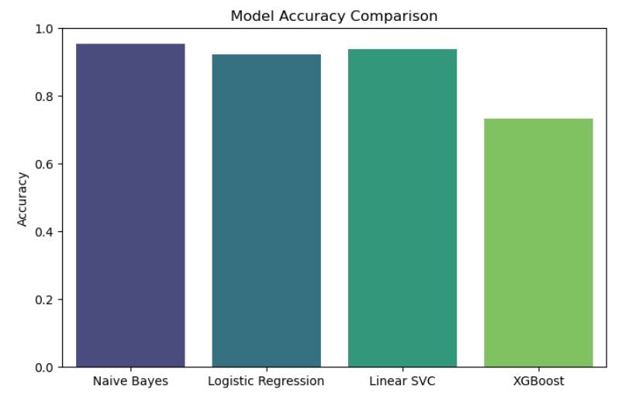
Model Training & Evaluation
Cross-Validation
Test Set Results
Selection Rationale
5-fold stratified: Linear SVC leads with 97.23% accuracy, low std (0.0097). Naive Bayes close at 96.83%. XGBoost
underperforms on sparse features.
Naive Bayes tops test accuracy (95.31%, F1 0.9535); Linear SVC at 93.75%.
Highlights simpler models' generalization.
Chose Linear SVC for stable CV scores, better unseen data handling. Metrics: Accuracy, Precision, Recall, F1.
Confusion matrices show minimal misclassifications.
Linear SVC ensures reliable production predictions.

Slide 10
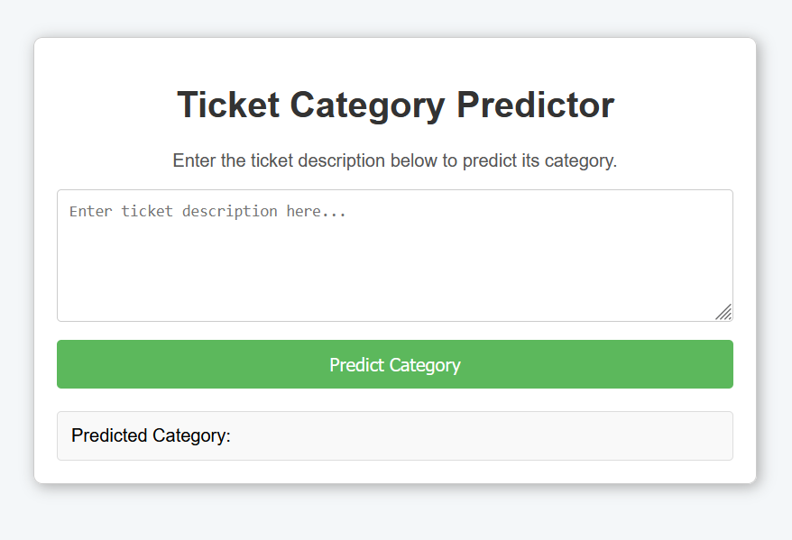
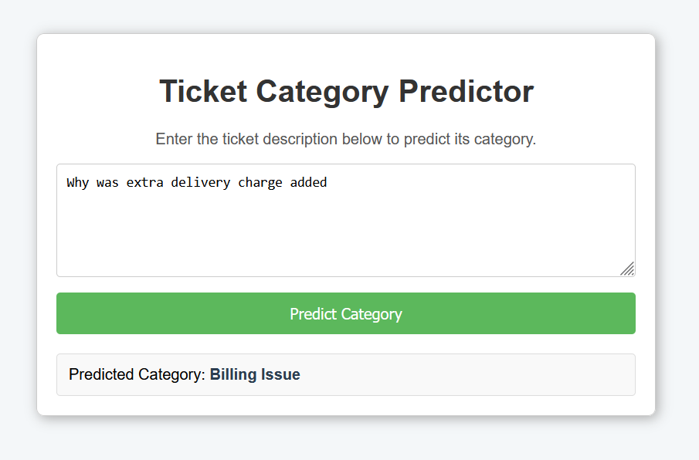
Deployment & Conclusion
The trained model was deployed using Flask with a simple HTML frontend inside Jupyter Notebook.
Users can enter ticket descriptions and get instant category predictions through the /predict route.
This deployment demonstrates a complete end-to-end workflow from model training to real-time application, proving the system’s ability to automate and streamline customer support efficiently.
Output Windows

